Slide 1

NAME: E.G.PRADEEP ROLL NO : RA2211004050026 DEP: B.TECH.ECE SUB: DESIGN THINKING METHODOLOGY SUB CODE : 21DCS201P

Slide 2
MIND MAP : 1.A mind map geared towards implementing ideas is a visual representation that organizes the steps and components necessary to turn a concept or plan into reality. 2. It starts with a main idea right in the middle, then branches out into smaller ideas connected to the main one. 3. it generates ideas and exploring different possibilities around a central topic or problem. 4.Mind maps serve as visual aids during presentations, allowing presenters to organize key points, facts, and concepts in a structured and engaging manner. 5.Mind maps help in defining and visualizing personal or professional goals, breaking them down into actionable steps, and tracking progress over time.

Slide 3

MIND MAP EXAMPLE :

Slide 4
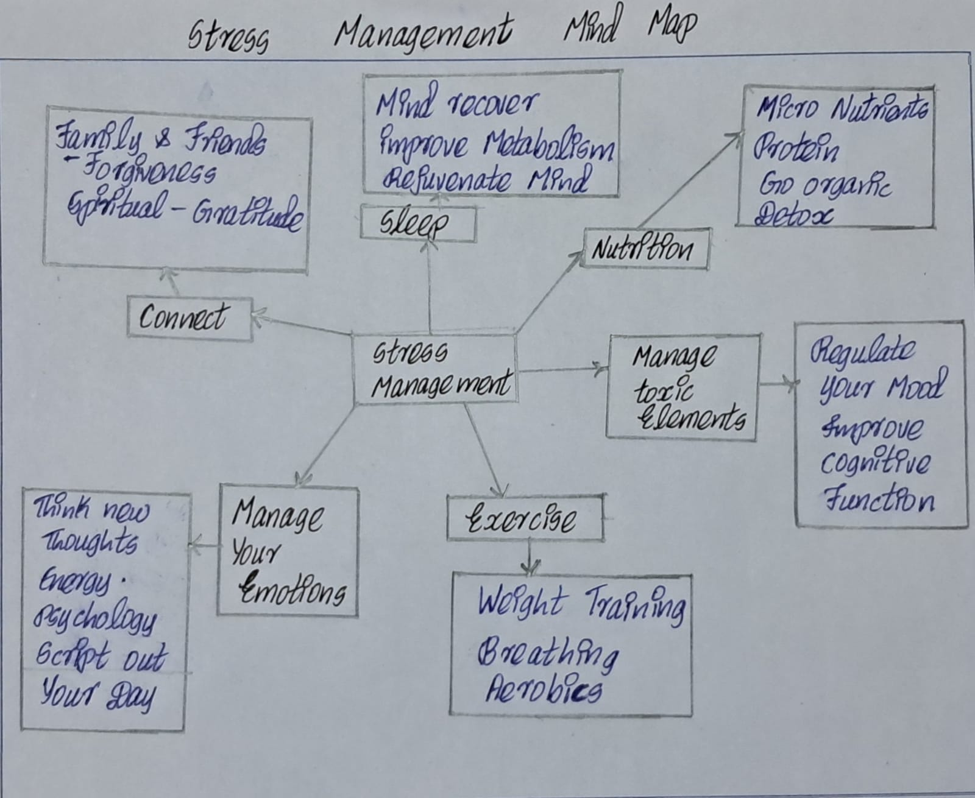
MY ASSIGNMENT :

Slide 5
THANK YOU

